Slide 1
RAPIDS: GPU-powered data science
Marko Kvakić
19.10.2023 @ ai2future
Notes:
<number>

Slide 2
Outline
Rapids
What is it?
Why is it fast?
How do I use it?
ai2future 2023.
2023.10.19

Slide 3
Rapids
Data science powered by CUDA
"Everything" on the GPU
A familiar data science API
NumPy, Pandas, sklearn
Integration with the ecosystem
XGBoost
BlazingSQL
spark-rapids
ai2future 2023.
2023.10.19

Slide 4
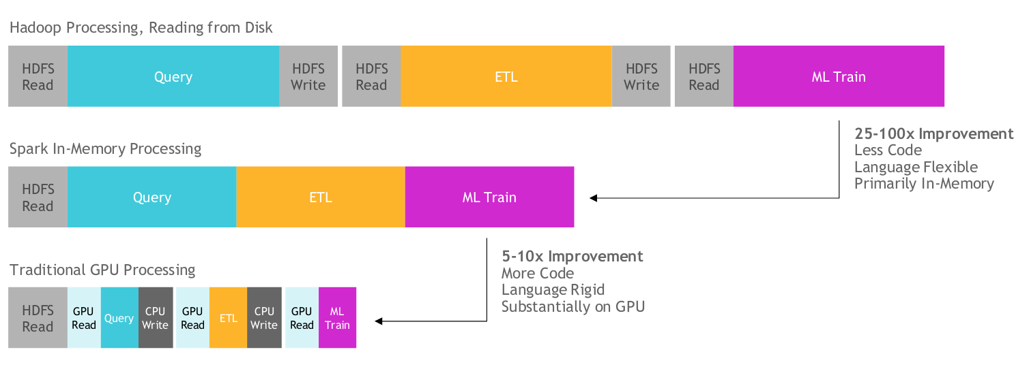
Data processing
ai2future 2023.
2023.10.19

Slide 5
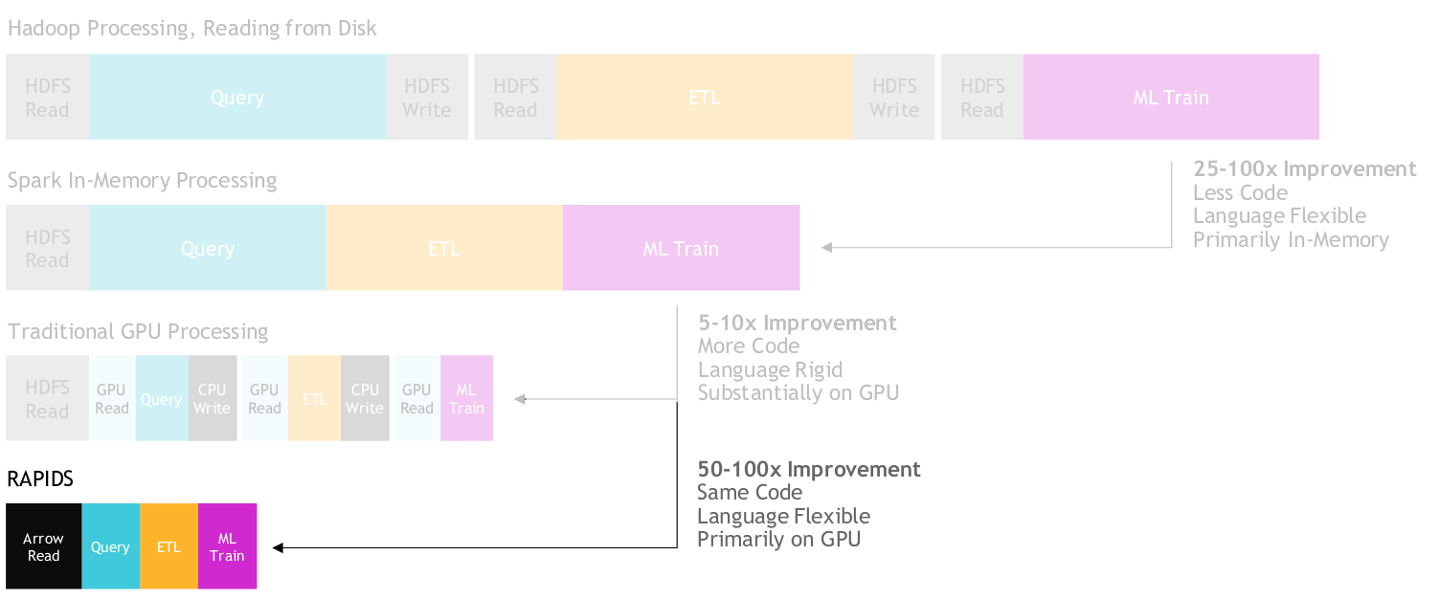
Data processing & RAPIDS
ai2future 2023.
2023.10.19

Slide 6
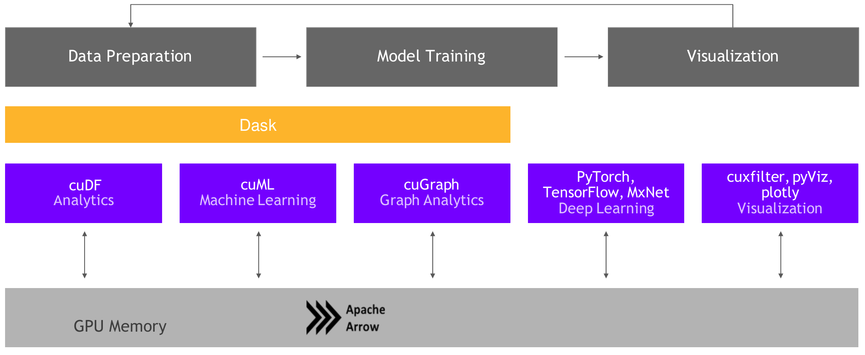
Rapids components
ai2future 2023.
2023.10.19

Slide 7
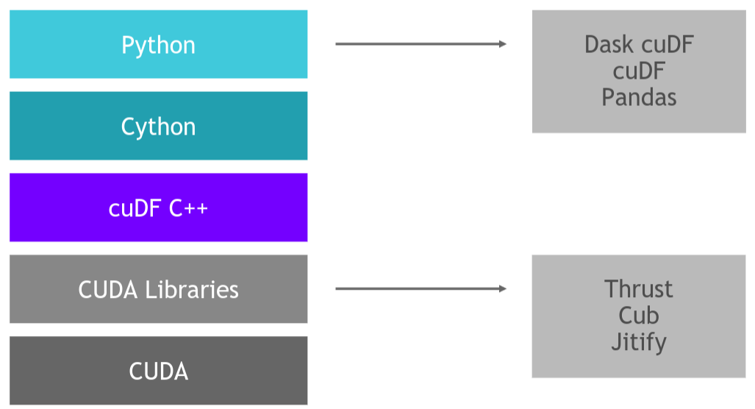
cuDF – Pandas on the GPU
A collection of CUDA kernels optimized for sorting, joining, aggregations...
Components
libcuDF – C++ libraries
cuDF – Python API
ai2future 2023.
2023.10.19

Slide 8
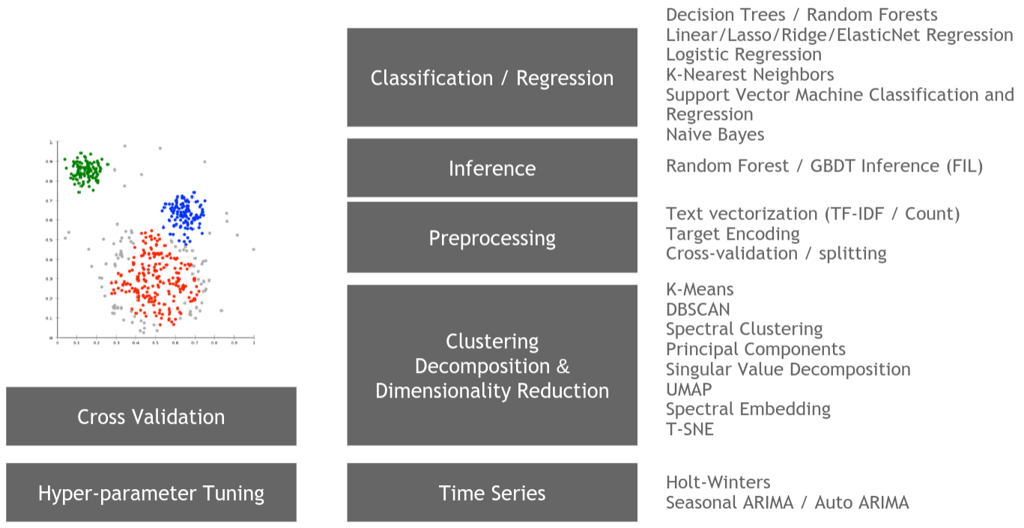
cuML – sklearn
CUDA port of sklearn algorithms
Native support for XGBoost
GPU ⟷ CPU model transfer
Provides support for saving fit forest models
23.10 - prototyping on the CPU, fitting on the GPU
ai2future 2023.
2023.10.19

Slide 9
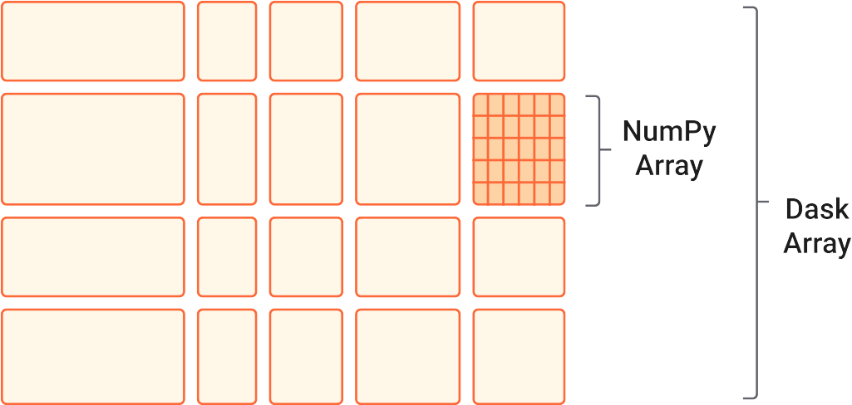
Dask – distributed computing in Python
Framework for distributed Python applications
Geared towards large scale data processing
Operations as computational graphs
Tasks and values
Asynchronous scheduling via a dask cluster
ai2future 2023.
2023.10.19

Slide 10
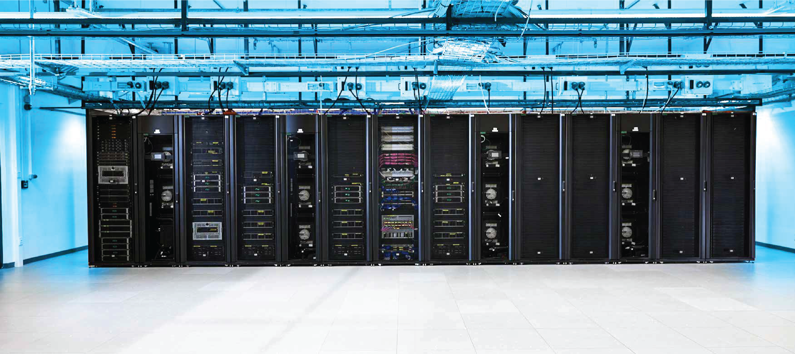
Vrančić computing @ SRCE
Resources
11520 AMD Epyc 7713 @ 2.00 GHz
16 NVIDIA A100 @ 40GB
57,5 TB of RAM
200 TB of NVMe storage
1 PB of HDD storage
2 x 25 Gbit/s interconnect
Cloud computing
Provisioning via OpenStack
JupyterLab
Galaxy
ai2future 2023.
2023.10.19

Slide 11
NYC Taxi Dataset
NYC Taxi Dataset
Daily commute in the New York Metropolitan area
≈ 10**9 rows
Model
Ride count per day for a specific location
Random forest
ai2future 2023.
2023.10.19

Slide 12
Exercise preparation
Username form
Please type in a username you would like to have
max. 20 people
JupyterHub server
ai2future.srce.hr
ai2future 2023.
2023.10.19

Slide 13
Thank you for your attention
computing@srce.hr
NAZIV DOGAĐANJA
DATUM

